Slide 1
London School of Hygiene & Tropical Medicine
Introduction to Infectious Disease Modelling and its Applications
R modelling demo session
Improving Health Worldwide

Slide 2
Outline
2
We will:
Make sure you have downloaded R and RStudio
Download the “modeller” demo
Model the first 10 months of the COVID-19 pandemic in the UK

Slide 3

Download the demo
Go to:
tinyurl.com/LSHTM2026
Unzip the file “ModellerDemo.zip”
Go into the ModellerDemo folder
Open ModellerDemo.Rproj
Start by running setup.R

Slide 4
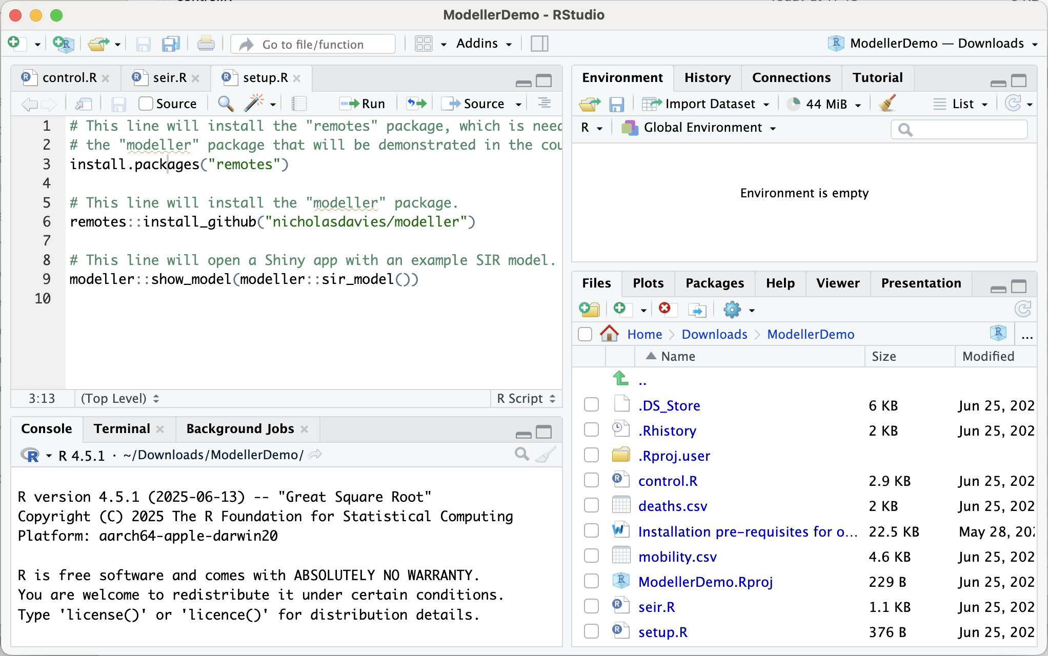
Running setup.R
Click “source” to run setup.R
tinyurl.com/LSHTM2026

Slide 5
Open seir.R
tinyurl.com/LSHTM2026

Slide 6
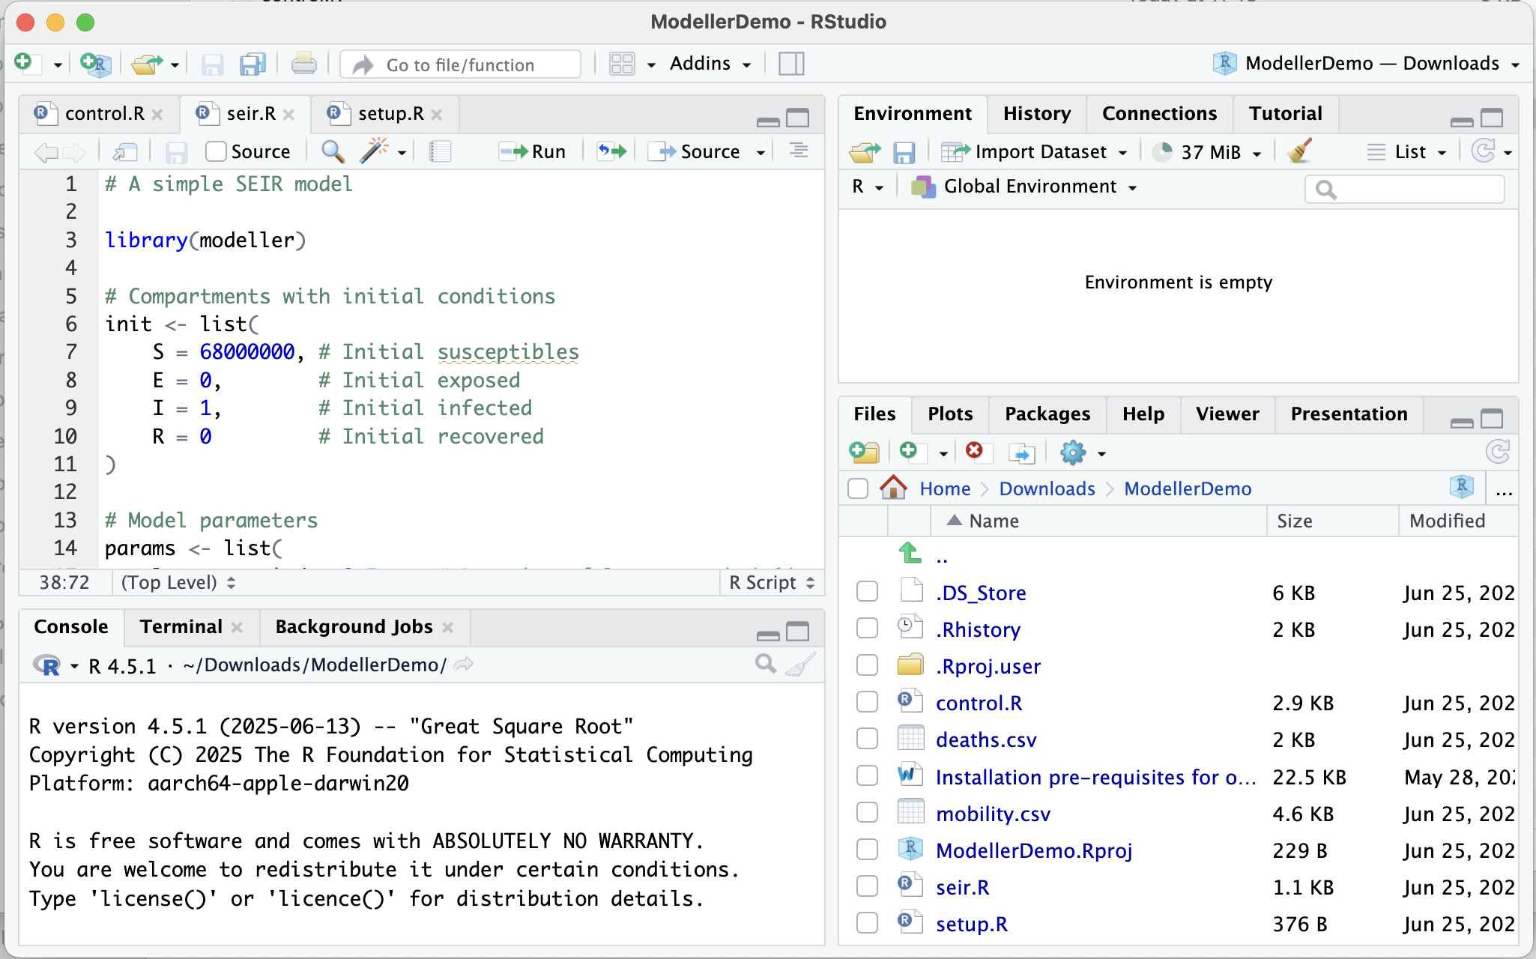
Running seir.R
tinyurl.com/LSHTM2026

Slide 7
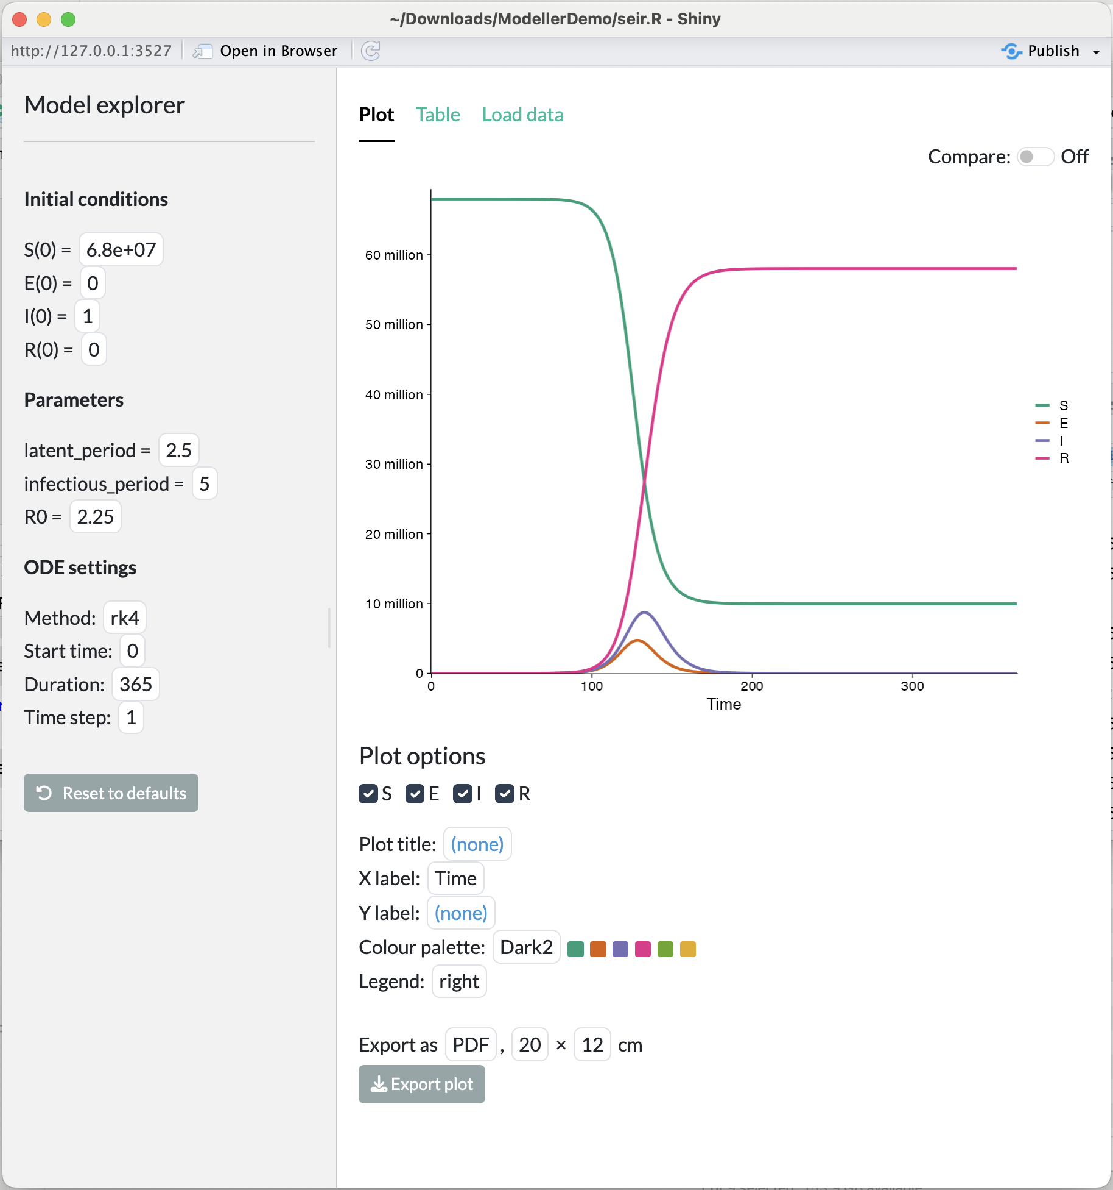
Model explorer
Adjust initial conditions and parameters on the left
Click on the plot to read values. What is the prevalence of infectious people at the epidemic peak?
Can you get the epidemic to peak on day 100?
tinyurl.com/LSHTM2026

Slide 8
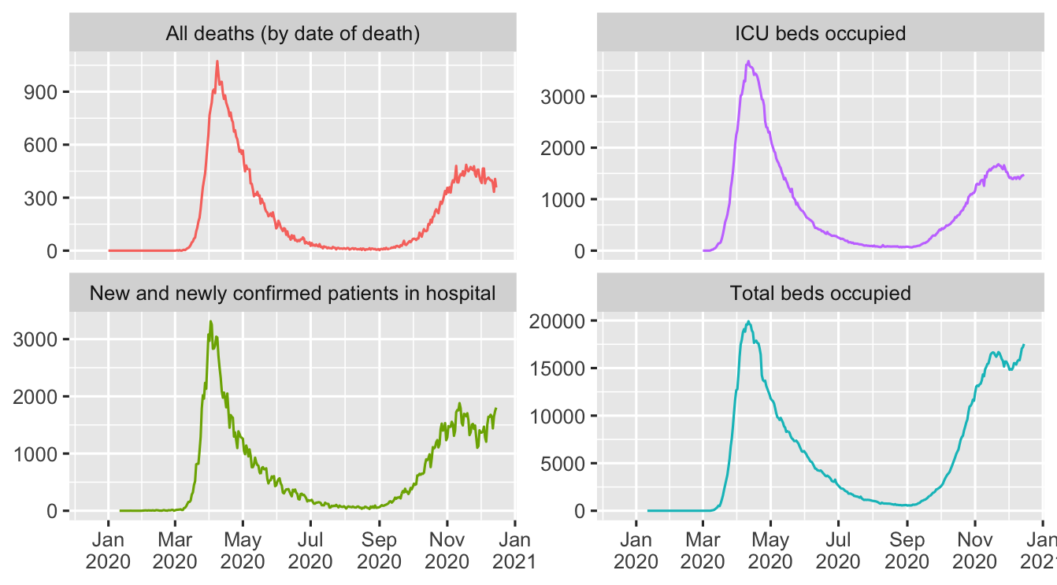
The first 10 months of COVID-19 in the UK
Data provided to modellers by SPI-M
Includes deaths, hospital admissions, ICU beds occupied, total beds occupied
We will calibrate our model today to deaths
tinyurl.com/LSHTM2026

Slide 9
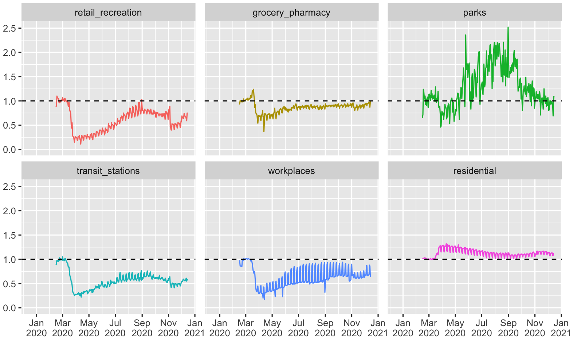
Google mobility indicators
Based on mobile phone data from users of Google apps
Provided in the public domain during the pandemic for a large number of countries
Very helpful resource…
tinyurl.com/LSHTM2026

Slide 10
Open control.R
tinyurl.com/LSHTM2026

Slide 11
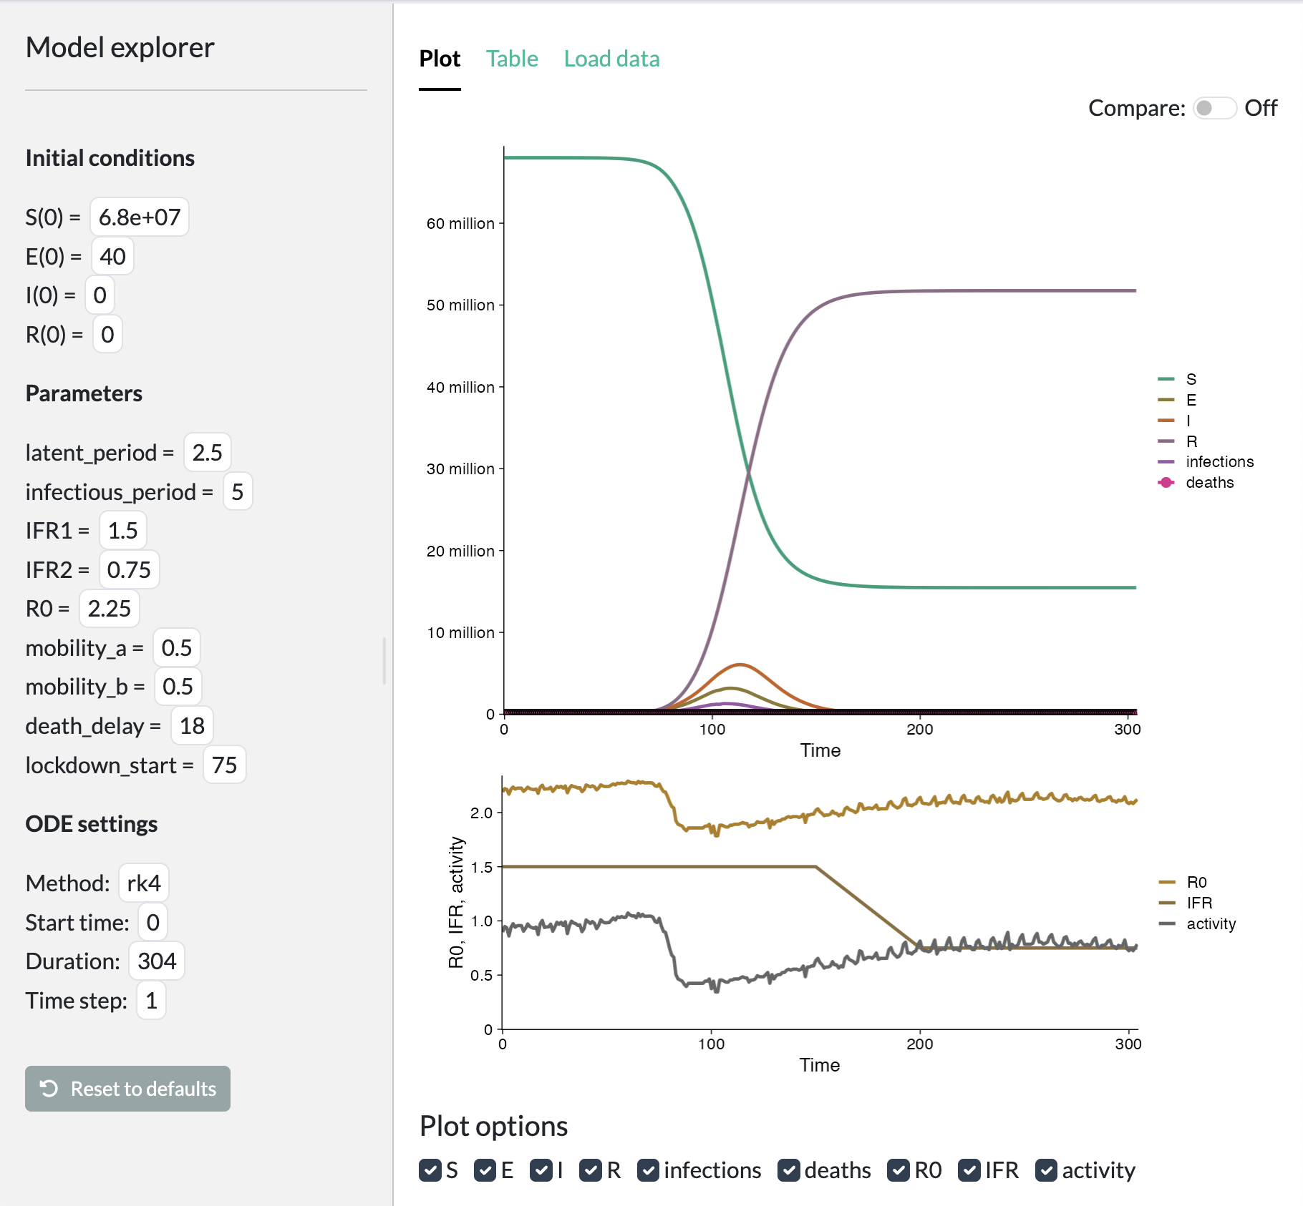
Open control.R
Deselect S, E, I, R, infections below the plot
Adjust `mobility_a` and mobility_b on the left to change how R(t) depends on the activity indicator and match to the number of deaths over time
Can you get the model to line up (approximately)?
What happens if you adjust the date of lockdown (lockdown_start) by plus or minus a week?

Slide 12
London School of Hygiene & Tropical Medicine
Introduction to Infectious Disease Modelling and its Applications
R modelling demo session
Improving Health Worldwide

